Slide 1
How Mallard turns a question into a study design plan
Models draft and review. Deterministic code decides what may be printed.
WHAT THIS TALK COVERS
The seven steps from a plain-language question to a plan
What it asks for that a general chatbot does not, and why that lowers the risk of statistical malpractice
Who decides what: the investigator, the models, and the code
Where it does not yet help
Juleon Rabbani, DrPH · 17 September 2026
Notes:
One minute. State the framing line once: models draft and review, code decides what may be printed. Everything that follows is that sentence unpacked. Say early that this is a planning aid for a statistician and an IRB to check, not a replacement for either.

Slide 2
A plan is never the output of one model
Four numbers that describe the process, all read from the deployed code
6
2
37
7
workspace phases, each ending in a gate the investigator confirms, with the design settled in Phase 3
independent model reviewers, Anthropic and OpenAI, merged worst case
deterministic checks: 17 estimand rules and 20 validators
check codes that withhold the sample size outright, never with a warning under it
Two model reviews run only where a wrong answer does the most harm: the design brief and the analysis step. The deterministic checks run on every step, and no model can overrule them.
If the sizing method does not fit what the study measures, the number is withheld rather than shown with a caveat.
Notes:
Ninety seconds. The point is the division of labour, not the counts. Models supply the reasoning; code supplies the discipline. The last line is the one sentence to remember.

Slide 3
Six phases, each ending in a gate the investigator confirms
The workspace is the default entry; the design is settled in Phase 3 and the plan credit is spent in Phase 4
Models draft; two labs review the brief and the analyses
Deterministic gates and checks
Generated on the investigator's press
PHASE 1
PHASE 2
PHASE 3
PHASE 4
PHASE 5
PHASE 6
Question and aims
Feasibility
Design confirmation
Analysis and sizing
Execution and budget
Finalise and export
Aims suggested with placeholders; roles and claims set; the aims check; a PubMed literature scan.
Free. Gate: 1 to 3 aims with roles.
Seven questions, each answered with a basis and an owner; the variable map on request.
Free. Gate: every row has a basis and a result.
Estimand and variables first, then the free brief: design, conditions, up to three alternatives.
Free brief. Gate: estimand, variables, design confirmed.
Build the study, then draft each aim's analysis, sizing and exhibits; edit, update, accept.
One plan credit. Gate: the biostatistician checkpoint.
Operations, governance, tasks, timeline and budget drafted on request; readiness recorded.
Gate: ready, conditional, or infeasible.
Written package and code per language on request; reconciler named; export with review record.
Gate: nothing pending, no open comments.
A later decision can reopen an earlier phase. Before an edit is saved, the investigator sees what generated work it affects and what is preserved.
Notes:
Two minutes. Walk the row left to right. Stress three things: the estimand and variables come before the design is recommended; the design is confirmed before a credit is spent; and execution, the write-up and code are drafted only when asked for. The seven generation steps of the pipeline still exist underneath, but the investigator sees these six phases.

Slide 4
What it asks for that a general chatbot does not
Typed facts the code can hold the plan to, not free text a model fills from its priors
Context governs feasibility, never validity
Data state against the chosen design
Aims with a role and a claim
Nine typed fields: use, deadline, data state and source, funding, team roles, who analyses. Resources decide whether a method is reachable; they never make a weaker method acceptable. A test fails if any prompt says "simplest analysis" or "in a spreadsheet".
Records already in hand against a randomised or prospective design is a blocking conflict. Generate stays disabled until the investigator says which statement is true.
Each aim is primary confirmatory, secondary confirmatory or exploratory, with an intended claim. A confirmatory aim requires a hypothesis and makes multiplicity fields mandatory. Placeholders are bracketed, never invented.
A typed estimand
Variables with roles, timing and missingness
Feasibility with a basis, counts reconciled
Target, population, exposure, comparator, outcome, summary measure, time horizon, assignment mechanism, clustering, repeated measures, competing events. Seventeen rules compare sizing, analysis and figures to it.
Outcome, exposure, confounder, mediator, effect modifier, selection factor. A variable that is both confounder and mediator blocks. The map refuses to choose an adjustment set for you.
Every answer is a checked result or a planning assumption with an owner. A record count is never treated as evidence of power, and a count not yet established carries a caveat into the package.
A chatbot can be prompted to ask all of this. It cannot refuse to print a number when the answers contradict each other.
Notes:
Three minutes; this is the slide the audience came for. Pick two cards to say out loud: context never changes validity, and the typed estimand. The closing band is the argument: the safeguard is not the questions but the refusal that follows from typed answers.

Slide 5
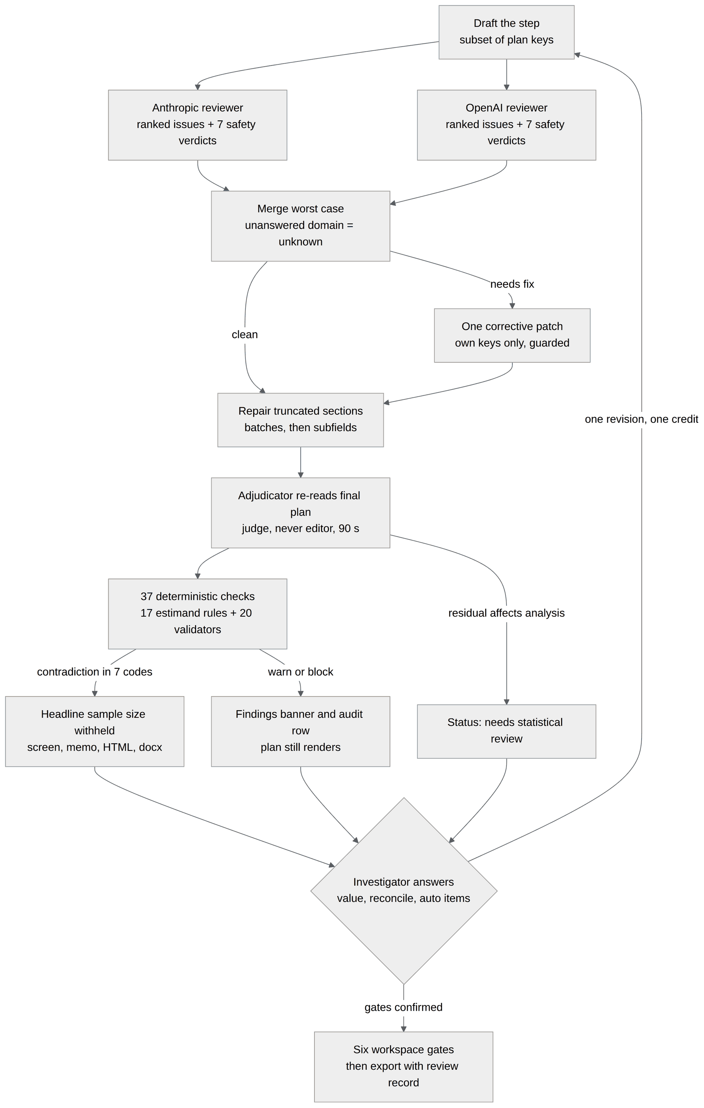
How a draft becomes a plan
Two reviews, one guarded revision, a judge that never edits, then the code, then the investigator
1
Two reviewers, merged worst case
Each returns ranked issues plus a verdict on seven safety domains. An unanswered domain is unknown, never pass, and a concern reaches the revision even without an issue slot.
2
One guarded corrective patch
Only the step's own sections. A patch that changes a type, truncates, empties a section or invents a reviewer response is dropped; a thinner revision is rejected.
3
An adjudicator that judges, never edits
It re-reads the final plan against the reviewer issues within 90 seconds. Its verdict is shown to the reader and never rewrites the plan.
4
The deterministic layer has the last word
Thirty-seven checks read the typed estimand, sizing method, analysis, diagram and exhibits and compare them. Seven codes withhold the sample size everywhere.
5
The investigator closes the loop
An edit to a confirmed decision is previewed with the work it affects. Update affected sections regenerates only the stale parts, and the result is held with a diff until it is accepted or discarded.
Notes:
Two minutes. The diagram is the same loop as the document. The thing to land is that the checks sit below every model and cannot be talked round, and that the loop back to a draft is driven by the investigator's answers, not by the models retrying.

Slide 6
What failing looks like
The plan is never blanked or regenerated by the checks. Findings are ranked and always shown.
OUTCOME
TRIGGER
WHAT THE INVESTIGATOR SEES
Warning
Any warn-level finding
A banner above the plan, and the finding named in the audit's consistency row in every export
Block
Any block-level finding
The same banner, red, headed "This plan contradicts itself"
Headline withheld
One of seven headline-suppressing codes, or an unresolved reviewer point typed as affecting the sample size
No sample-size number anywhere: screen, memo, HTML, Word. The panel says whether the reason is a contradiction, an open review point, or that no formula fits
Needs statistical review
An unresolved reviewer point affecting the primary analysis
A status carried to the screen, memo, audit and library card. The analysis stays visible
A false positive that shows a blank screen destroys work a paid credit bought. So a contradiction removes the number, not the reasoning, and the reader can see why.
Notes:
Ninety seconds. Leaders tend to ask what happens when it is wrong; this is the answer. Four outcomes in increasing weight. The number is what people act on, so the number is what gets withheld.

Slide 7
Who decides what
Every activity sits in one of three lanes, and nothing reaches the export without the third
LANE 1
LANE 2
LANE 3
The investigator
Stochastic language models
Deterministic code
● 11 typed inputs and 4 presses
Context fields, aims and hypotheses, feasibility answers, estimand and variables, answers to the model, analysis contract and sizing inputs, counts, execution, finalisation. Presses: build study, draft analyses, draft execution, write-up and code.
● 11 decisions
Confirmatory or not, aims-check disposition, basis per answer, approve or alternative, each design condition, data requests, multiplicity, save or update after an edit, accept or discard a result, readiness, write-up and code.
● Draft and review
Suggest aims, draft the brief and each step, review as two independent labs, propose one patch, adjudicate.
● Output varies run to run
So nothing a model writes is trusted on its own. Every draft is checked against the typed facts before it is shown.
● Six phase gates and the checks between them
PHI stripping, the conflict gate, the credit check, the 37 plan checks, the recomputed number, count reconciliation, the stale-dependency map and the pending-result guard, then the export.
● The only reproducible lane
Same input, same verdict, every time. It is the only path to the export and the only thing that can withhold a number.
The one loop back from the code lane to the models is an investigator's decision edit, and its result waits for acceptance.
Notes:
Two minutes. This is the governance slide. The lanes are the answer to "where is the AI in this": it drafts and reviews; it does not decide what is printed. The next six slides walk the swimlane map panel by panel; the document has the same map with every tag explained.

Slide 8
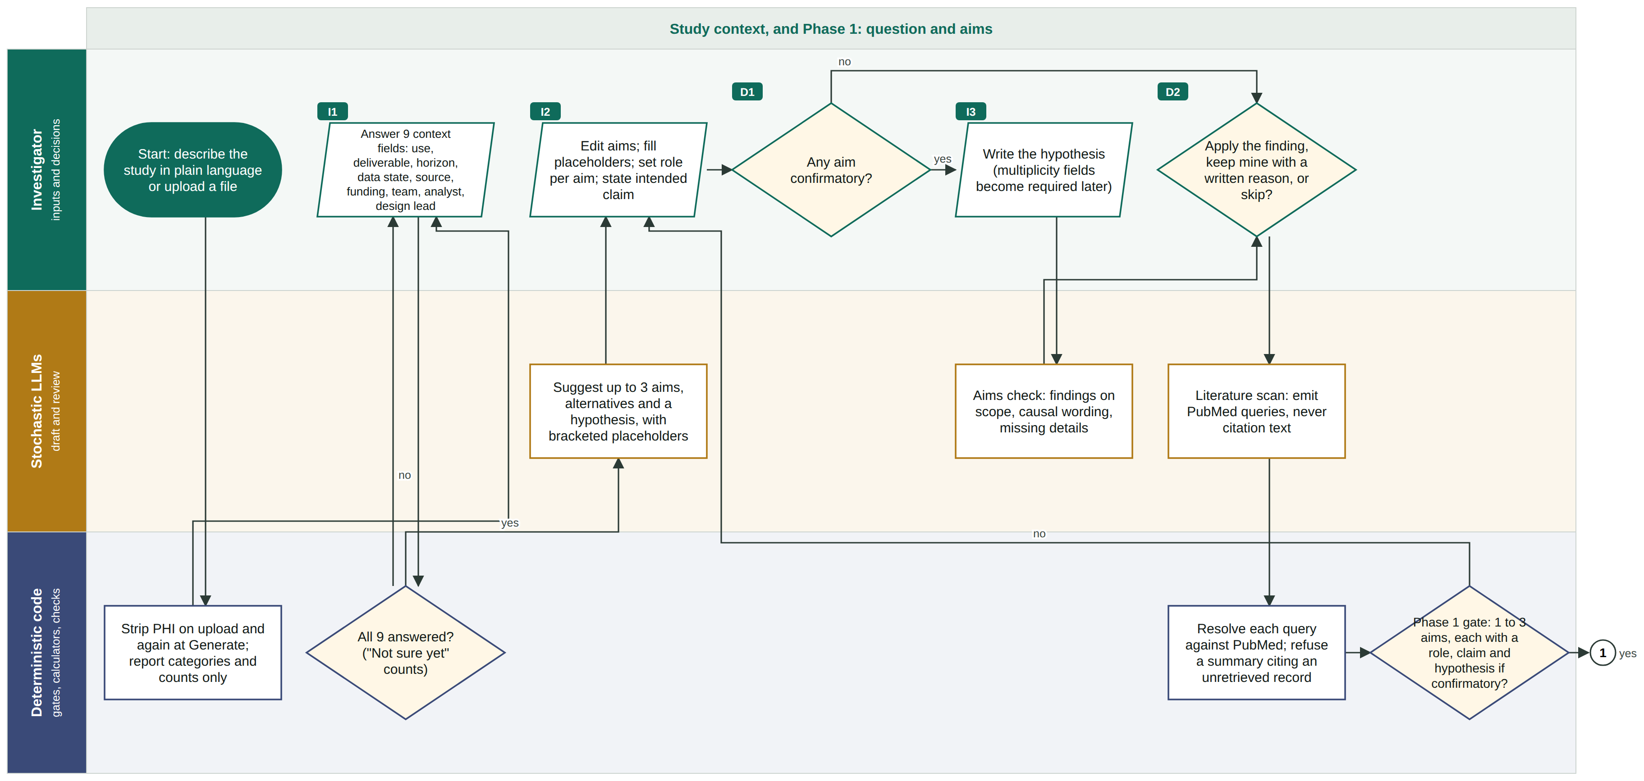
Process map 1 of 6: study context and Phase 1 aims
Parallelogram = investigator input · diamond = decision · rectangle = process · numbered circle = continues on the next panel
Context is pinned before anything is drafted.
Population, setting and constraints are typed facts, and identifying detail is stripped before any model sees the text. The question step asks its clarifying questions, and the investigator confirms the aims at the Phase 1 gate.
Tags I1 to I11 mark investigator inputs and D1 to D11 decisions, in the order they are asked.
Notes:
Thirty seconds. Do not read the panel. Point at the three lanes and the one thing in the sidebar, then move on. If time is short, show panel 5 (revision) only and treat the others as an appendix.

Slide 9
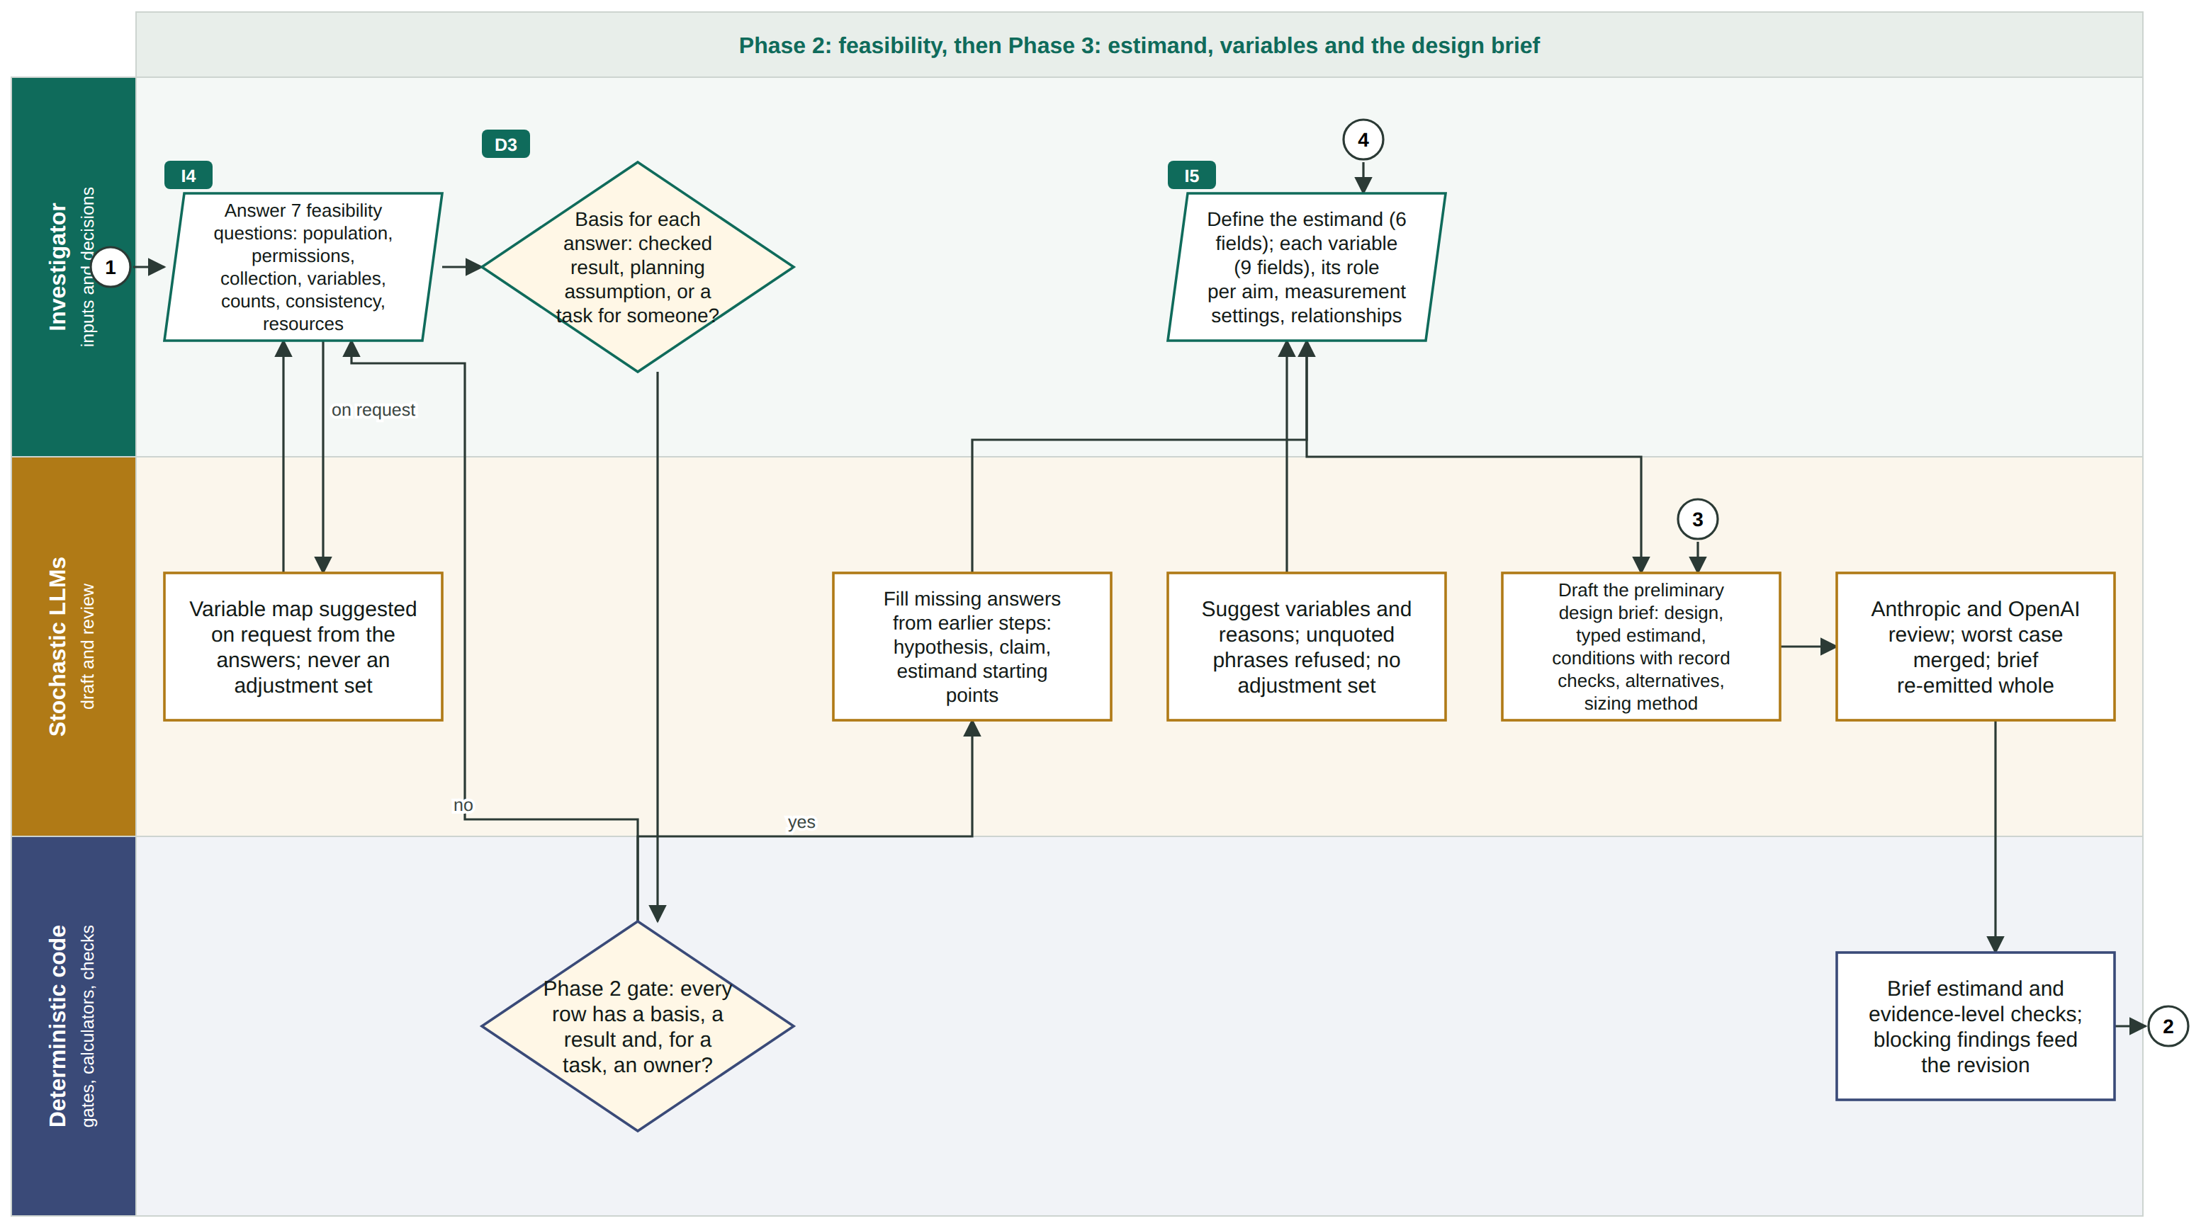
Process map 2 of 6: feasibility, estimand, variables, brief
Parallelogram = investigator input · diamond = decision · rectangle = process · numbered circle = continues on the next panel
Feasibility is entered as rows, not prose.
Recruitment, follow-up and resource limits become facts the code can check against. Phase 3 then settles the aim, hypothesis, estimand and variables before the design brief is generated.
Tags I1 to I11 mark investigator inputs and D1 to D11 decisions, in the order they are asked.
Notes:
Thirty seconds. Do not read the panel. Point at the three lanes and the one thing in the sidebar, then move on. If time is short, show panel 5 (revision) only and treat the others as an appendix.

Slide 10
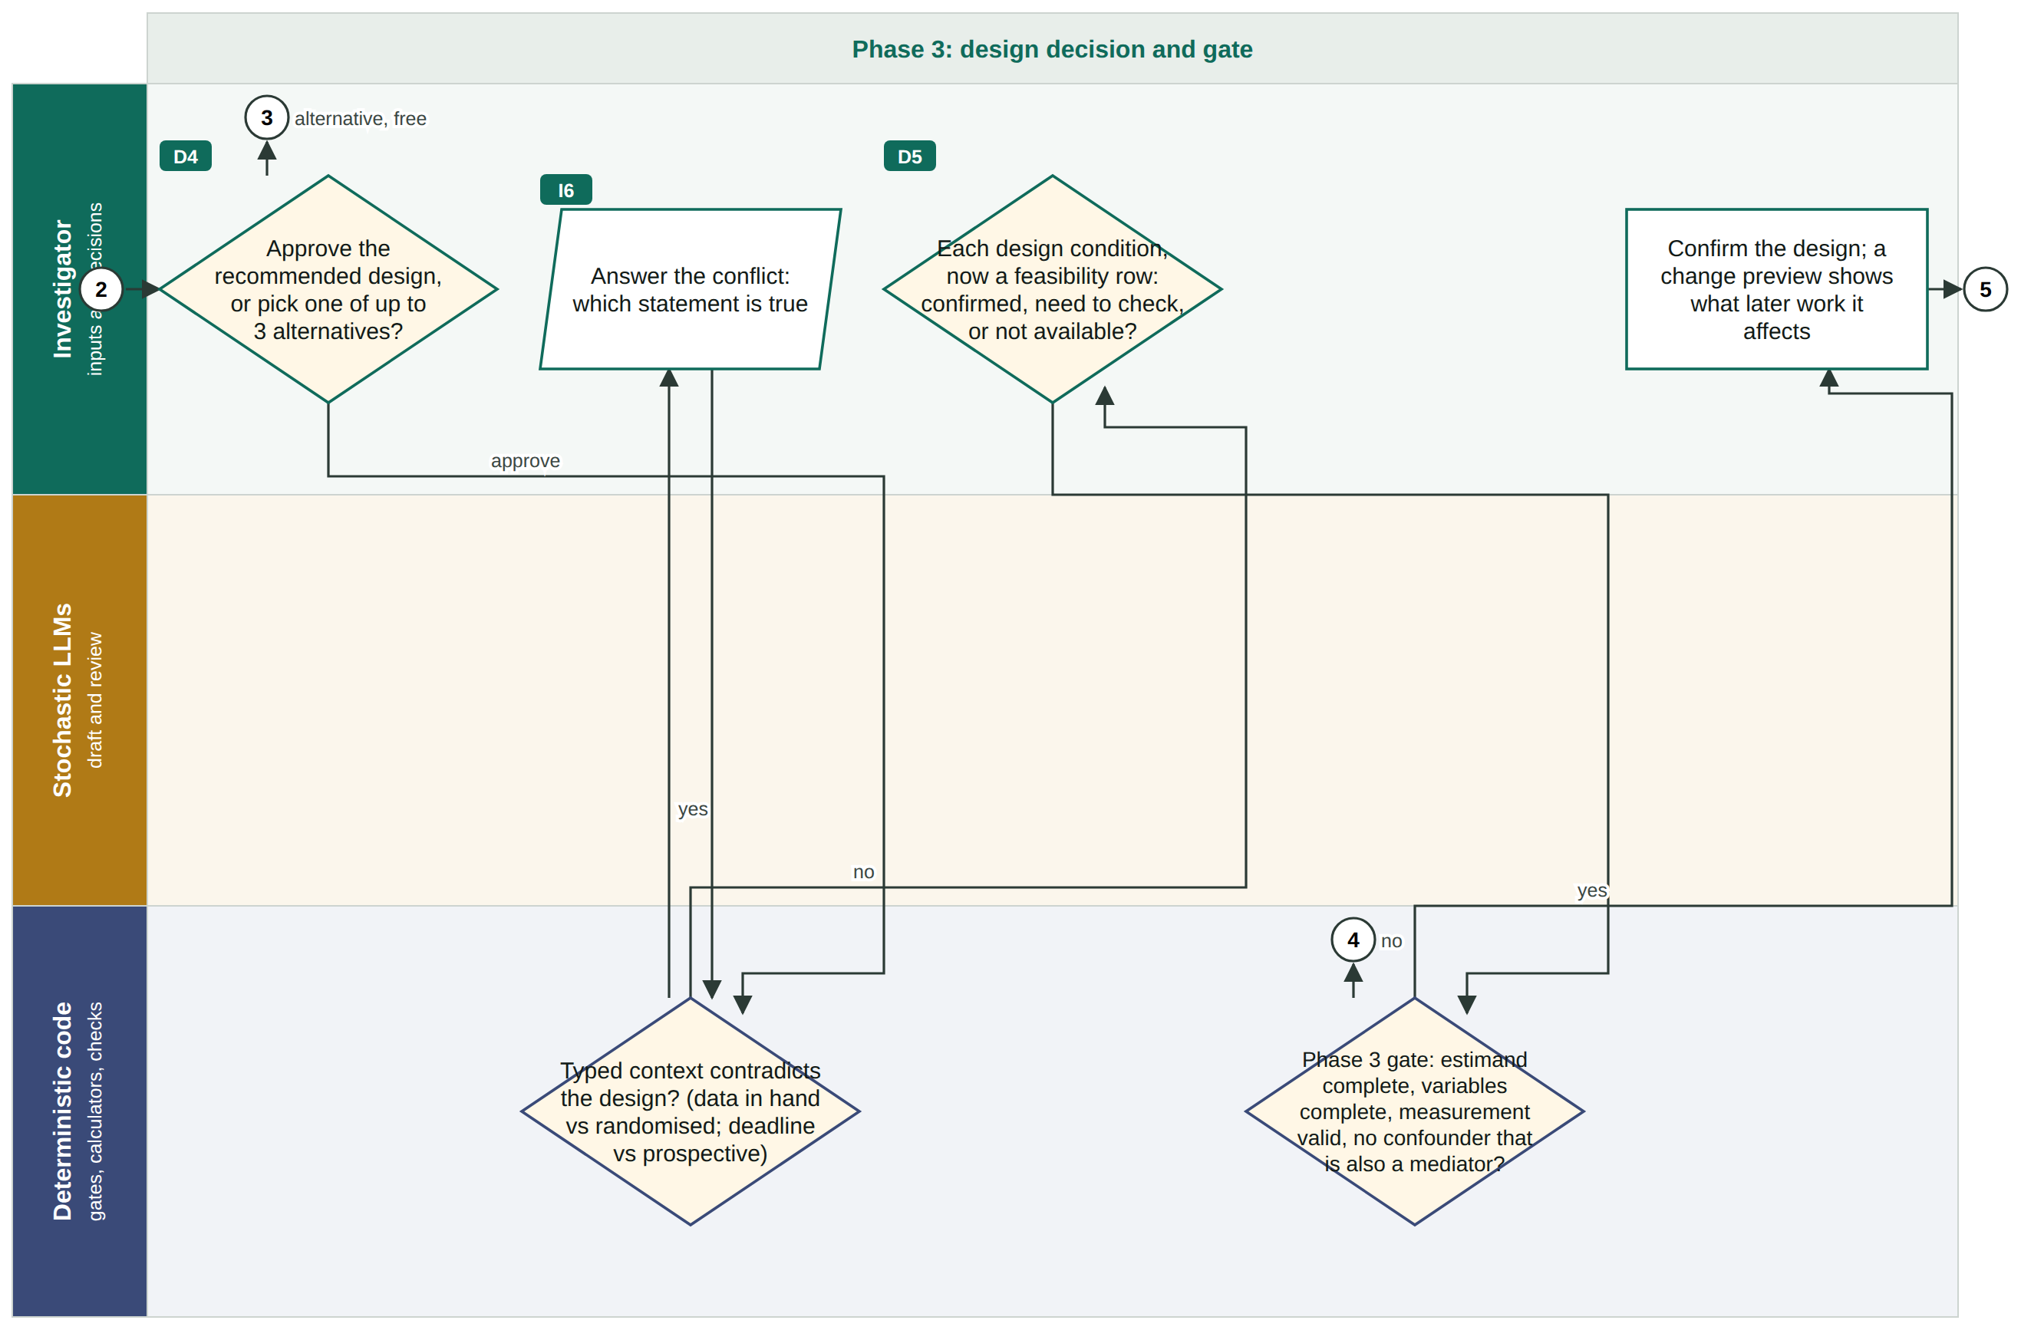
Process map 3 of 6: the design decision and its gate
Parallelogram = investigator input · diamond = decision · rectangle = process · numbered circle = continues on the next panel
The design is the investigator's decision.
The brief is drafted and reviewed, its conditions are appended as feasibility rows, and the investigator picks the design and confirms the gate. Nothing downstream can generate until this gate is confirmed.
Tags I1 to I11 mark investigator inputs and D1 to D11 decisions, in the order they are asked.
Notes:
Thirty seconds. Do not read the panel. Point at the three lanes and the one thing in the sidebar, then move on. If time is short, show panel 5 (revision) only and treat the others as an appendix.

Slide 11
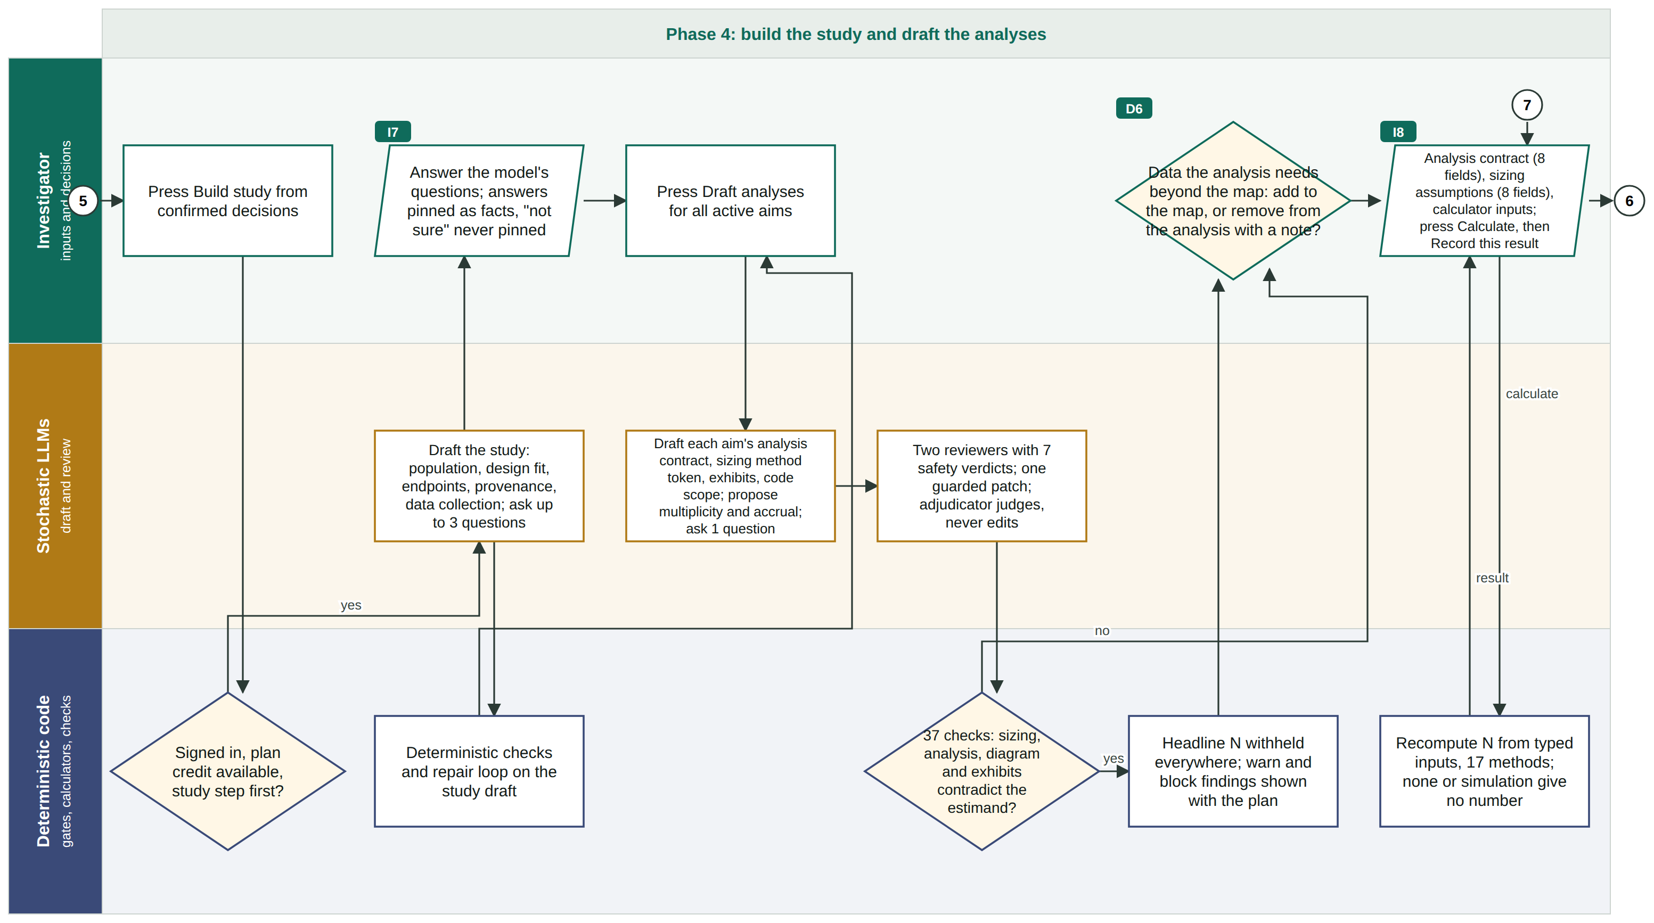
Process map 4 of 6: build the study, draft the analyses
Parallelogram = investigator input · diamond = decision · rectangle = process · numbered circle = continues on the next panel
Two separate presses, one plan credit.
Build study spends the plan credit and runs the deterministic sizing calculators. Draft analyses is a second press, and the analysis brief gets both the model review and the deterministic checks.
Tags I1 to I11 mark investigator inputs and D1 to D11 decisions, in the order they are asked.
Notes:
Thirty seconds. Do not read the panel. Point at the three lanes and the one thing in the sidebar, then move on. If time is short, show panel 5 (revision) only and treat the others as an appendix.

Slide 12
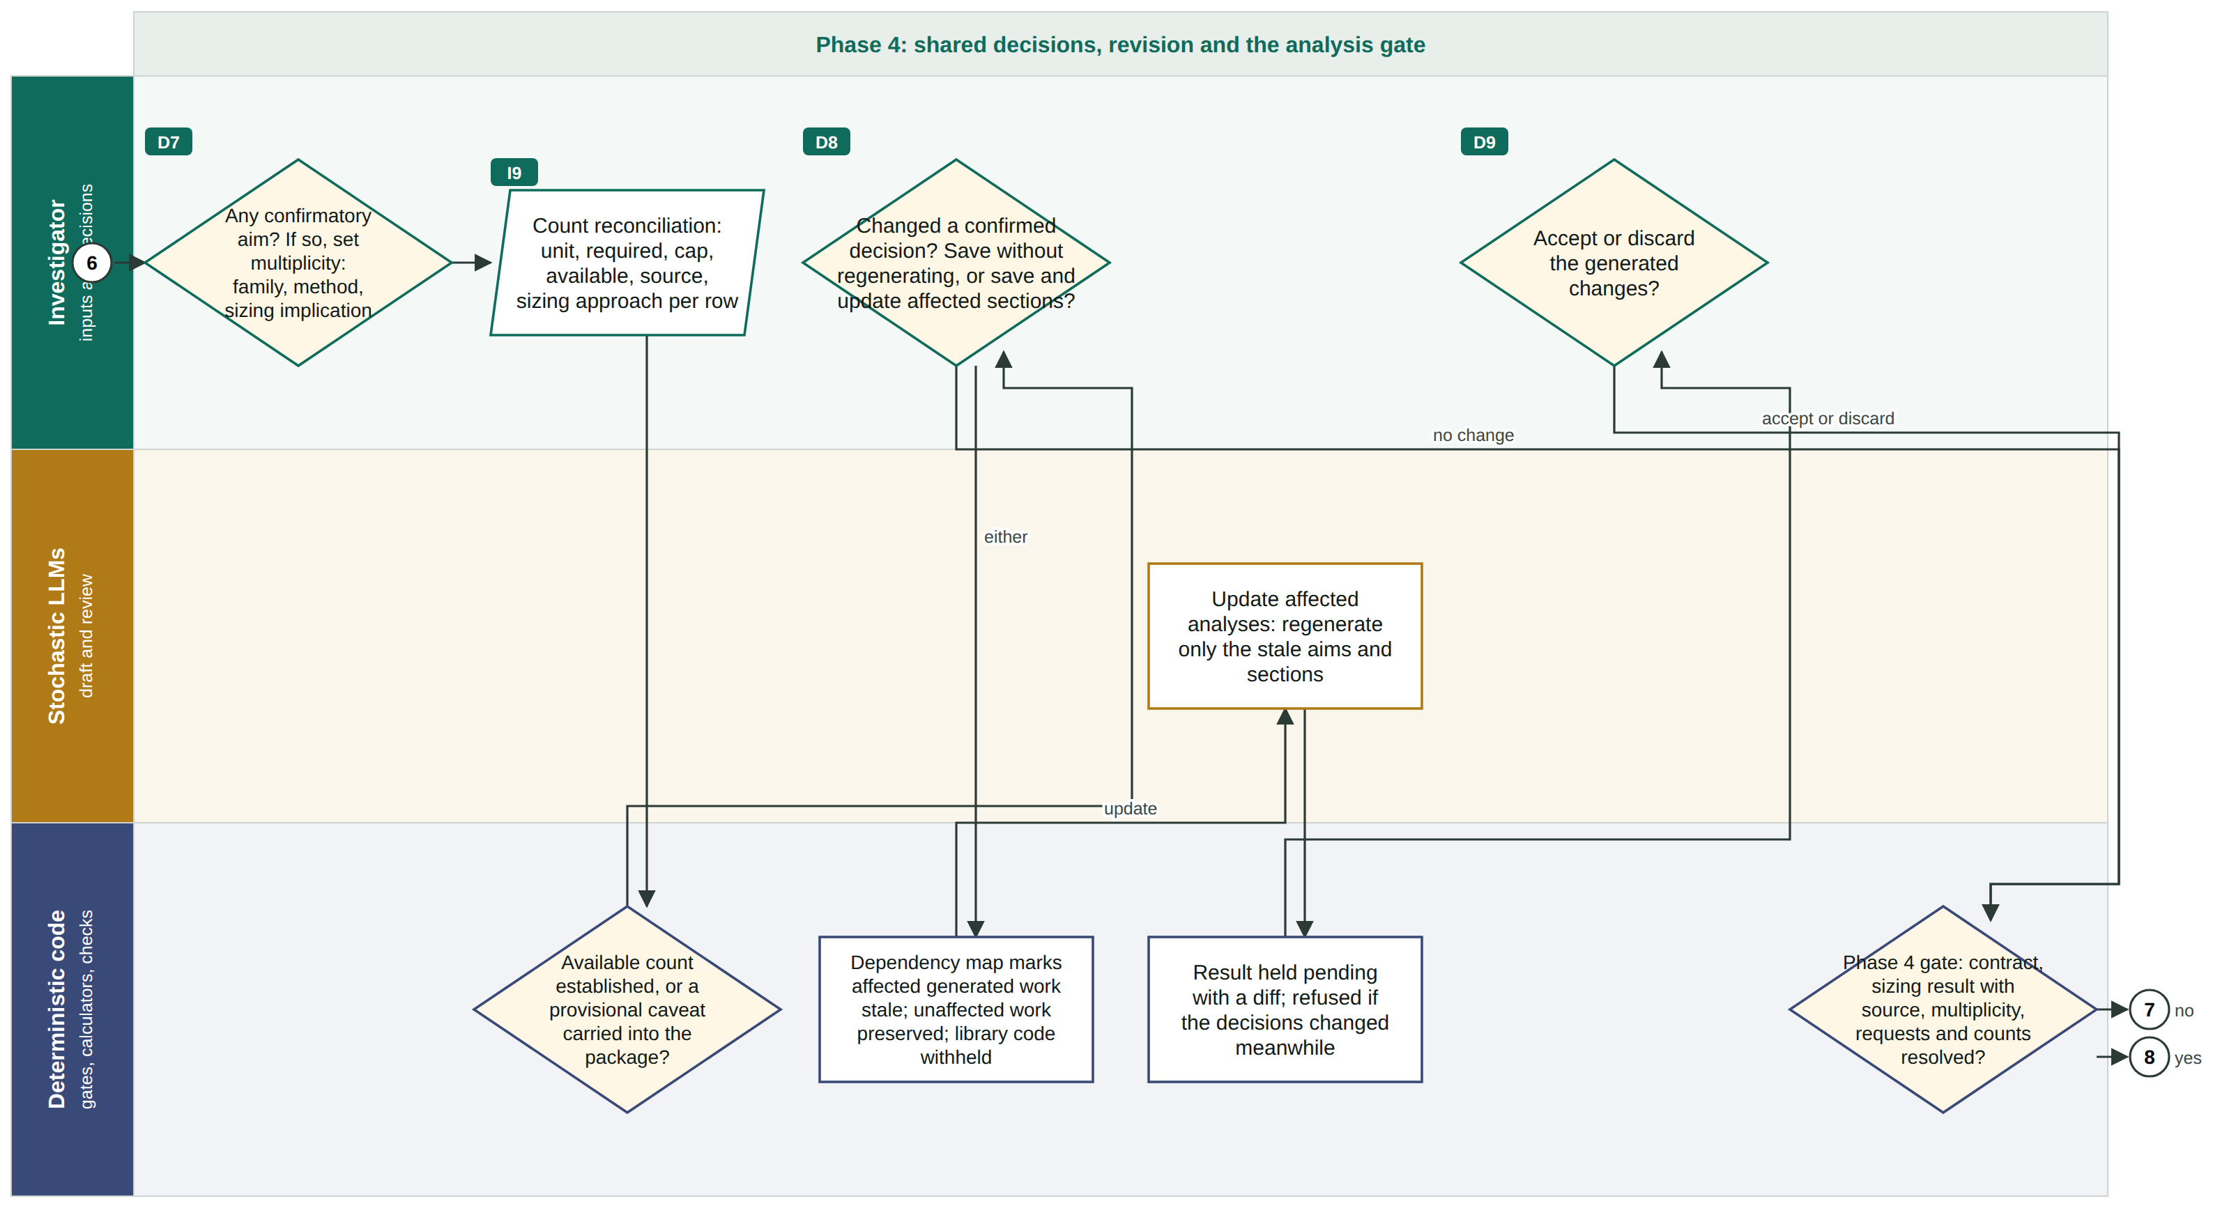
Process map 5 of 6: shared decisions and revision
Parallelogram = investigator input · diamond = decision · rectangle = process · numbered circle = continues on the next panel
Revision is previewed, not silent.
Multiplicity and counts are investigator decisions. An edit shows its impact, affected work is marked stale, an update regenerates only that work, and the result waits for acceptance or discard.
Tags I1 to I11 mark investigator inputs and D1 to D11 decisions, in the order they are asked.
Notes:
Thirty seconds. Do not read the panel. Point at the three lanes and the one thing in the sidebar, then move on. If time is short, show panel 5 (revision) only and treat the others as an appendix.

Slide 13
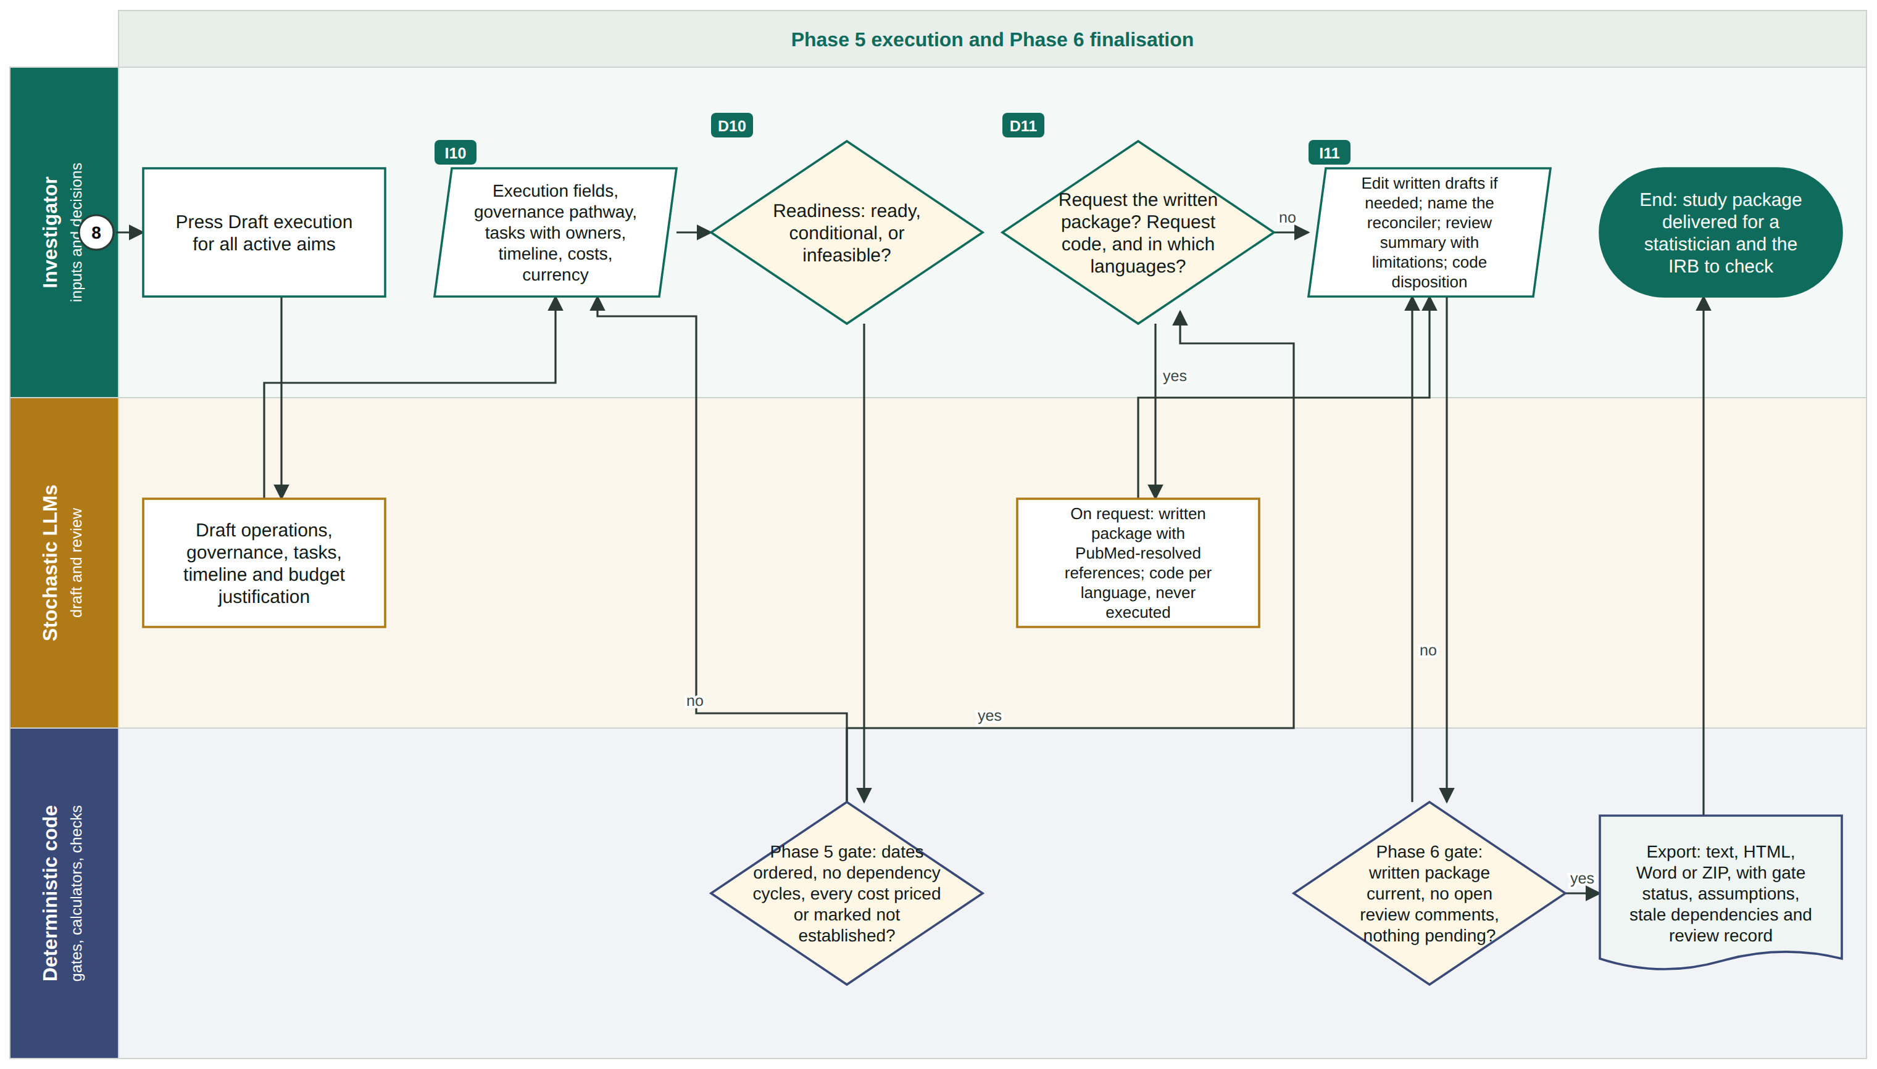
Process map 6 of 6: execution and finalisation
Parallelogram = investigator input · diamond = decision · rectangle = process · numbered circle = continues on the next panel
Execution runs on request, and the export is gated.
Execution is a press, not an automatic step. The write-up and code follow, references are verified against PubMed, and the finalisation gate holds the export until every blocking finding is cleared.
Tags I1 to I11 mark investigator inputs and D1 to D11 decisions, in the order they are asked.
Notes:
Thirty seconds. Do not read the panel. Point at the three lanes and the one thing in the sidebar, then move on. If time is short, show panel 5 (revision) only and treat the others as an appendix.

Slide 14
The eleven decisions an investigator makes
In the order they are asked, and who acts on each one next
D1
Any aim confirmatory?
D7
Multiplicity family, method and sizing implication
Investigator writes the hypothesis; multiplicity becomes required
Investigator reconciles counts; code Phase 4 gate
D2
Aims-check finding: apply, keep with a reason, or skip
D8
After an edit: save only, or update the affected sections
Model runs the literature scan
Code marks stale work; models regenerate only that
D3
Basis per feasibility answer: checked, assumption, or task
D9
Accept or discard the generated changes
Code Phase 2 gate; a task blocks design until closed
Code Phase 4 gate; the result is refused if decisions moved
D4
Approve the design, or pick an alternative
D10
Readiness: ready, conditional or infeasible
Model re-runs the brief, free; or code runs the conflict gate
Code Phase 5 gate; infeasible blocks the phase
D5
Each design condition: confirmed, to check, or not available
D11
Request the written package and code, and in which languages
Code Phase 3 gate, then the design confirmation
Models draft them on request; code is never executed
D6
Data beyond the map: add it, or remove from the analysis
Eleven more items are typed inputs rather than choices, and four are presses: build the study, draft the analyses, draft execution, and request the written package and code.
Investigator fills the analysis contract
Notes:
Two minutes. Do not read all eleven. Name D4, D8 and D9: the design approval that gates the credit, the save-or-update choice after an edit, and the explicit acceptance of anything regenerated. Appendix A of the document gives every option and its effect.

Slide 15
Where it does not yet help
Taken from the code, the Learn library and the roadmap notes, not inferred
Designs it will not size
The checks confirm naming, not application
Cluster and stepped-wedge rollouts, mediation, repeated measures, matched case-control, prediction models, equivalence: the method is named and no number is printed. Adaptive, Bayesian, platform and SMART designs have no path at all.
They confirm a plan named the right method. They cannot confirm it was applied correctly, that its assumptions hold, or that the plan is good. No rule covers interim analyses or alpha spending.
No independent evaluation
Code and citations are drafts
The evaluation was run by the person who built the tool, on scenarios he chose. There is no outcome evidence that studies planned with it are better studies. A September evaluation record measured the write-up step failing on about half of eight attempts.
Generated code is never executed, and every export says so. A reference is verified as a PubMed record, not as a claim: the investigator must confirm it supports the use.
The product's own methods page lists what it refuses: IRB determinations, final interpretation of results, a sample size it cannot justify, replacing collaborators, writing citations from memory.
Notes:
Two minutes. Lead with these rather than being asked. The independent-evaluation card is the honest one and the audience will respect it. Do not soften the write-up failure rate; say it was measured on eight attempts and has not been re-measured.

Slide 16
What to take from this
1
The safeguard is typed inputs plus a refusal to print
Any tool can ask good questions. Ask whether it can hold a plan to the answers, and what it does when they contradict.
2
Treat every output as a draft for a statistician and an IRB
The product says so on every export. The design brief and the pinned facts are what a consultation should start from.
3
Independent evaluation is the open question
The numerical core is pinned against R. Plan quality has not been independently judged, and that is the work to fund or to decline.
Full write-up, process map and the appendix of every decision: Mallard Study Design Process (shared Google Doc).
Notes:
Two minutes, then questions. Restate the three points. Point to the document for the six-panel map and Appendix A. Agree a next step and a date before leaving.

